Slide 1

Student Result Management System
By :- Rutu Devkar

Slide 2

Introduction
-The Student Result Management System is designed to store, manage, and analyze student academic records using MySQL.
-It provides a centralized database for students, courses, and examination results.
-This system helps in reducing manual errors, improving efficiency, and making result analysis easier.
-Queries can be used to generate reports such as top performers, pass/fail statistics, GPA calculation, and departmental analysis.
-The project demonstrates how databases can simplify real-life academic record management.
-

Slide 3
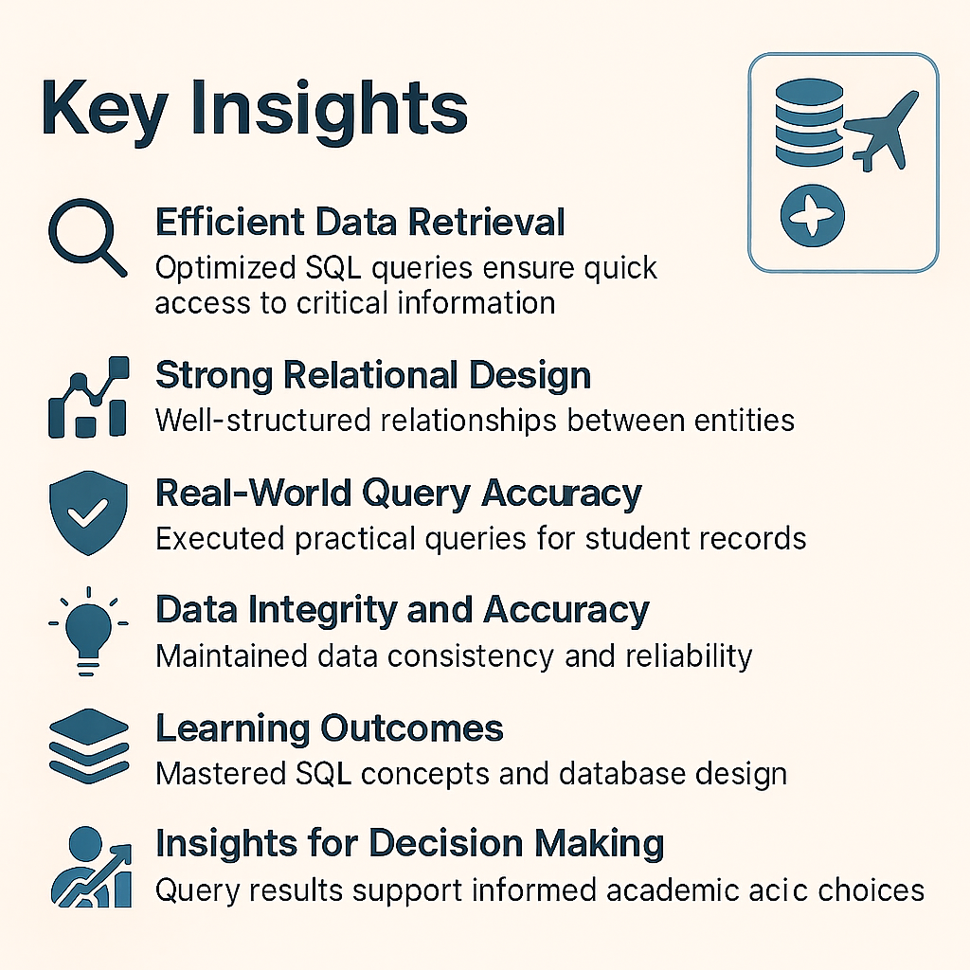
Key Insights Explanation
1. Efficient Data Retrieval
SQL queries are designed to fetch student results quickly.
Example: Retrieve top 10 students by GPA or all failed students instantly.
Ensures faster access for teachers and administrators.
2. Strong Relational Design
Database schema uses Students, Courses, Results tables with primary & foreign keys.
Prevents duplication and maintains referential integrity.
Enables smooth joins and relational queries.
3. Real-World Query Accuracy
Queries simulate practical academic operations like:
  Finding departmental toppers
  Calculating pass/fail ratios
  Generating transcripts
Ensures the system is applicable in real academic scenarios.
4. Data Integrity and Accuracy
Foreign keys ensure only valid student/course IDs can be inserted.
Prevents inconsistent data (e.g., marks without a valid student).
Maintains accuracy and reliability of records

Slide 4
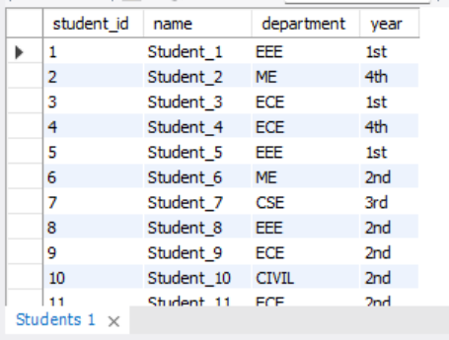
Q1. Show all students.
SELECT * FROM Students;

Slide 5
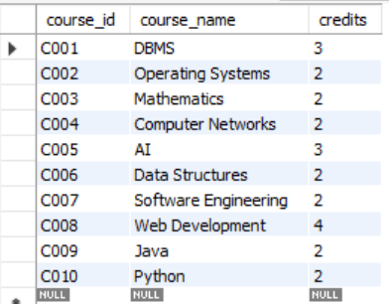
Q2. how all courses.
SELECT * FROM Courses;

Slide 6
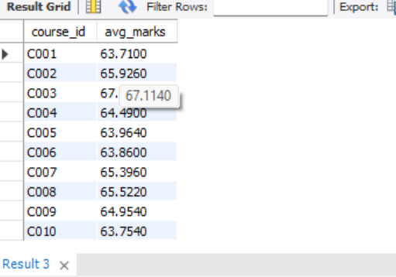
Q3 Average Marks by Course
SELECT course_id, AVG(marks) AS avg_marks
FROM Results
GROUP BY course_id;

Slide 7
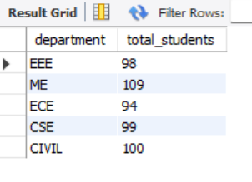
Q4 Number of Students Per Department
SELECT department, COUNT(*) AS total_students
FROM Students
GROUP BY department;

Slide 8
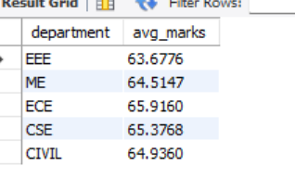
Q5 Average Marks by Department
SELECT s.department, AVG(r.marks) AS avg_marks
FROM Results r
JOIN Students s ON r.student_id = s.student_id
GROUP BY s.department;

Slide 9
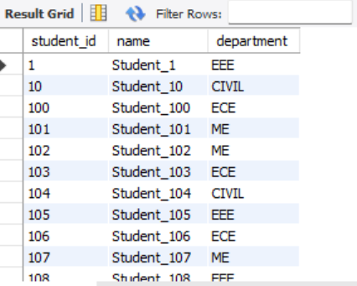
Q1.Students Ordered by Name (Alphabetical List)
SELECT student_id, name, department
FROM Students
ORDER BY name ASC;

Slide 10
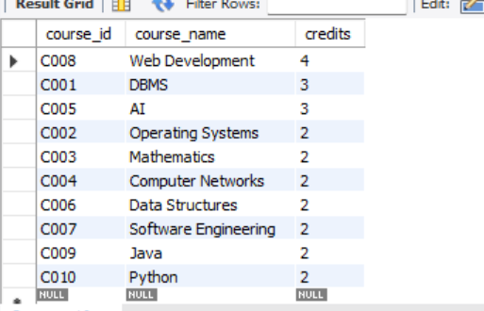
Q2. Courses Ordered by Credits (Highest First)
SELECT course_id, course_name, credits
FROM Courses
ORDER BY credits DESC;

Slide 11
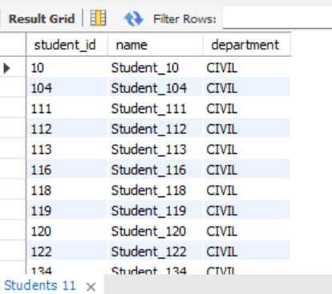
Q3.Students Sorted by Department then Name
SELECT student_id, name, department
FROM Students
ORDER BY department ASC, name ASC;

Slide 12
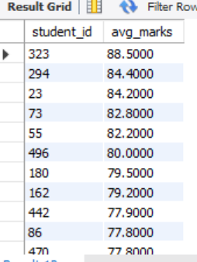
Q4.Students Ranked by Average Marks
SELECT r.student_id, AVG(r.marks) AS avg_marks
FROM Results r
GROUP BY r.student_id
ORDER BY avg_marks DESC;

Slide 13
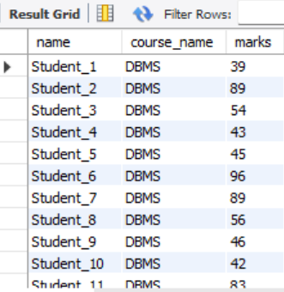
Q1.Show Student Names with Their Courses and Marks
SELECT s.name, c.course_name, r.marks
FROM Results r
JOIN Students s ON r.student_id = s.student_id
JOIN Courses c ON r.course_id = c.course_id;

Slide 14
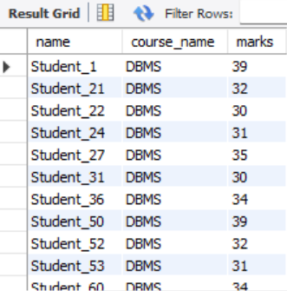
Q2. Show Students Who Failed in Any Course (marks < 40)
SELECT s.name, c.course_name, r.marks
FROM Results r
JOIN Students s ON r.student_id = s.student_id
JOIN Courses c ON r.course_id = c.course_id
WHERE r.marks < 40;

Slide 15
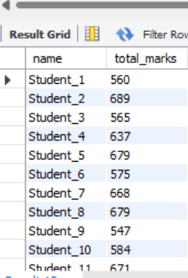
Q3. Show Total Marks of Each Student
SELECT s.name, SUM(r.marks) AS total_marks
FROM Results r
JOIN Students s ON r.student_id = s.student_id
GROUP BY s.name;

Slide 16
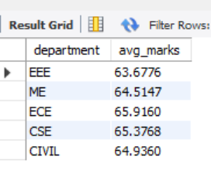
Q4. Show Average Marks Per Department
SELECT s.department, AVG(r.marks) AS avg_marks
FROM Results r
JOIN Students s ON r.student_id = s.student_id
GROUP BY s.department;

Slide 17
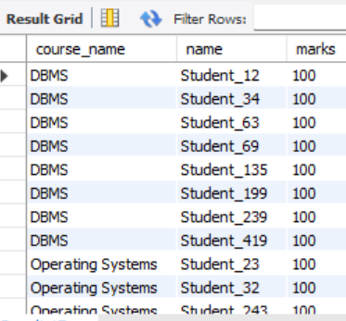
Q5. Show Top Scorer in Each Course
SELECT c.course_name, s.name, r.marks
FROM Results r
JOIN Students s ON r.student_id = s.student_id
JOIN Courses c ON r.course_id = c.course_id
WHERE r.marks = (
SELECT MAX(r2.marks)
FROM Results r2
WHERE r2.course_id = r.course_id
);

Slide 18
Conclusion
* The Student Result Management System helps in storing, managing, and analyzing student records easily.
* Using MySQL, we created a structured database with Students, Courses, and Results tables.
* With the help of SQL queries (GROUP BY, ORDER BY, JOIN, HAVING, etc.), we can:
  -Find toppers and weak students
  -Analyze departmental performance
  -Generate useful academic reports
* The system improves data accuracy, speed, and decision-making compared to manual methods.
* This project shows how databases are important in real-world education systems.

Slide 19
THANK YOU

Slide 20
Student Result Management System

